Slide 1

Bank Marketing Campaign Success Prediction
Data Glacier Internship Group Project
30th May 2023
By: Campaign Catalysts

Slide 2
Team Members
S.No. | Name | Email | Country | College/ Company
1. | Yash Jayesh Doshi | yashjdoshi99@gmail.com | UAE | Orpheuss LLC
2. | Anuj Singh | dsanuj21@gmail.com | India | Mumbai University
3. | Yash Jadwani | yash.jadwani1998@gmail.com | United Kingdom | Kingston University
4. | Harold Wilson | haroldwilson537@gmail.com | United Kingdom | University of Buckingham

Slide 3
Agenda
Problem Description
Business Understanding
About the Data
EDA Results
ML Model training summary
Final Recommendations

Slide 4
Problem Description
ABC Bank wants to sell its term deposit product to customers and before launching the product they want to develop a model which help them in understanding whether a particular customer will buy their product or not (based on customer's past interaction with bank or other Financial Institution).
Bank wants to use ML model to shortlist customer whose chances of buying the product is more so that their marketing channel (tele marketing, SMS/email marketing etc.) can focus only to those customers whose chances of buying the product is more.

Slide 5
Business Understanding
In this problem statement, the marketing strategy involves promoting the term deposit product to potential customers through various channels such as tele marketing, SMS, email marketing, etc. The aim of the marketing strategy is to reach out to a large number of customers and convince them to purchase the product.
However, it can be a costly and resource-intensive process to target every customer. Therefore, ABC Bank wants to develop a machine learning model that can help them identify the customers who are more likely to buy the product. This way, the marketing efforts can be focused on these shortlisted customers, which can significantly increase the chances of success while reducing marketing costs and resources.
By leveraging the insights gained from the machine learning model, ABC Bank can optimize their marketing campaigns, tailor their marketing messages to specific customers, and improve their overall customer acquisition strategy. The bank can also use the model to identify the most effective marketing channels for each customer segment, such as email marketing for younger customers and tele marketing for older customers, for example.
Overall, the goal of the marketing strategy is to increase the customer base and revenue of ABC Bank by targeting the right customers with the right product at the right time, while maximizing the return on investment of their marketing efforts.

Slide 6
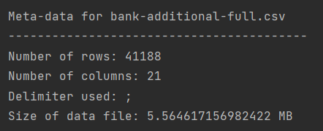
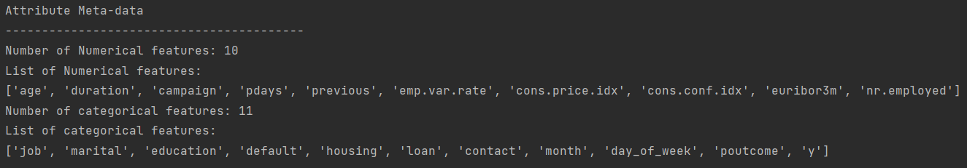
About the Data

Slide 7
About the Data
Feature Name | Data Type | Missing Values% | Unique Values% | Minimum Value | Maximum Value
age | int64 | 0 | 0 | 17 | 98
job | object | 0 | 0 | admin. | unknown
marital | object | 0 | 0 | divorced | unknown
education | object | 0 | 0 | basic.4y | unknown
default | object | 0 | 0 | no | yes
housing | object | 0 | 0 | no | yes
loan | object | 0 | 0 | no | yes
contact | object | 0 | 0 | cellular | telephone
month | object | 0 | 0 | apr | sep
day_of_week | object | 0 | 0 | fri | wed
duration | int64 | 0 | 3 | 0 | 4918
campaign | int64 | 0 | 0 | 1 | 56
pdays | int64 | 0 | 0 | 0 | 999
previous | int64 | 0 | 0 | 0 | 7
poutcome | object | 0 | 0 | failure | success
emp.var.rate | float64 | 0 | NA | -3.4 | 1.4
cons.price.idx | float64 | 0 | NA | 92.201 | 94.767
cons.conf.idx | float64 | 0 | NA | -50.8 | -26.9
euribor3m | float64 | 0 | NA | 0.634 | 5.045
nr.employed | float64 | 0 | NA | 4963.6 | 5228.1
y (target variable) | int64 | 0 | 0 | 0 | 1

Slide 8
Overall Business Analysis
Opportunities
Market Growth: The private cab industry in the USA grew rapidly during this time period. According to a report by Statista, the revenue of the US ride-hailing market was estimated to be $14.3 billion in 2016 and grew to $36.5 billion in 2018, representing a compound annual growth rate of 46.5%.
Challenges
Intense Competition: With growing demand came in intense competition between private companies. According to data from Certify, a travel and expense management software company, in 2016, Uber was the most expensed ride-sharing service for business travel, accounting for 43% of all ride receipts, while taxis represented only 14% of receipts.
Technological advancements: Cab companies started leveraging technology to improve their services, increase efficiency, and reduce costs. For example, some companies started using GPS systems to optimize routes, mobile apps to book cabs, and digital payment systems to enhance convenience.
Deregulation: In some cities, the deregulation of the cab industry led to increased competition and lower prices, which made cab services more accessible to customers.
Regulation: Some cities introduced stricter regulations for ride-sharing services, which made it more difficult for cab companies to compete on a level playing field.
Rising costs: Cab companies faced rising costs, such as higher insurance premiums and fuel costs, which impacted their profitability.

Slide 9
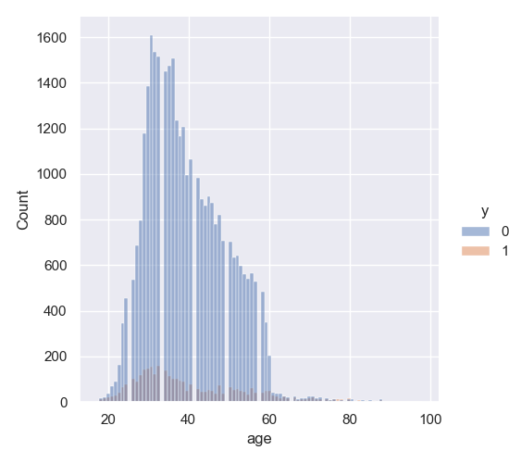
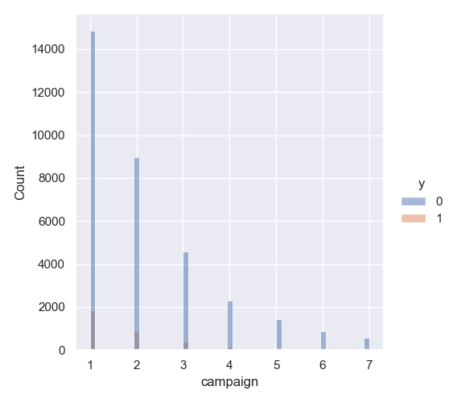
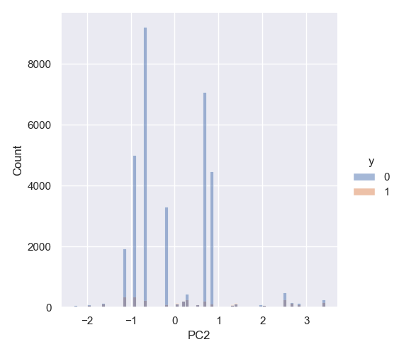
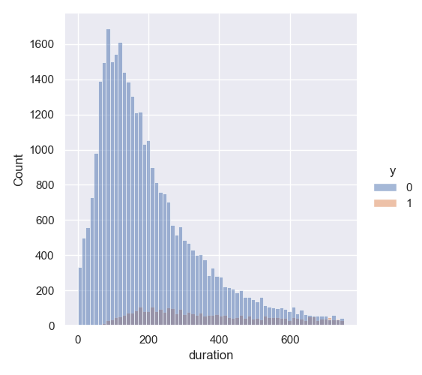
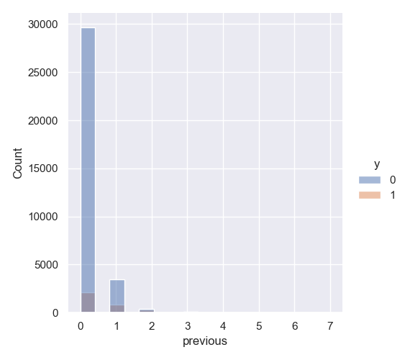
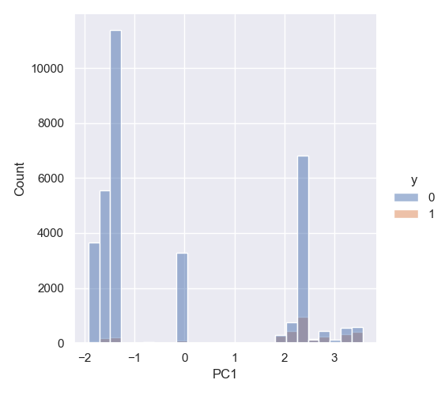
EDA Results: Distribution of Numerical features

Slide 10
EDA Results: Observations for Numerical features
Observations:
Age: Most of the calls were made to people aged 25-50. Percentage of subscriptions seems to be approximately constant across all ages.
Duration: As expected, percentage of subscriptions increases with the increase in call duration.
Campaign: There seems to be almost no subscriptions for more than 4 contacts in the current campaign.
Previous: Data is heavily skewed to number of contacts = 1. Percentage of conversion seems to be consistent with overall value.
PC1 and PC2: There seems to be some correlation with target variable. But the trend is not clear, this may be clearer when coupled with month and year values.

Slide 11
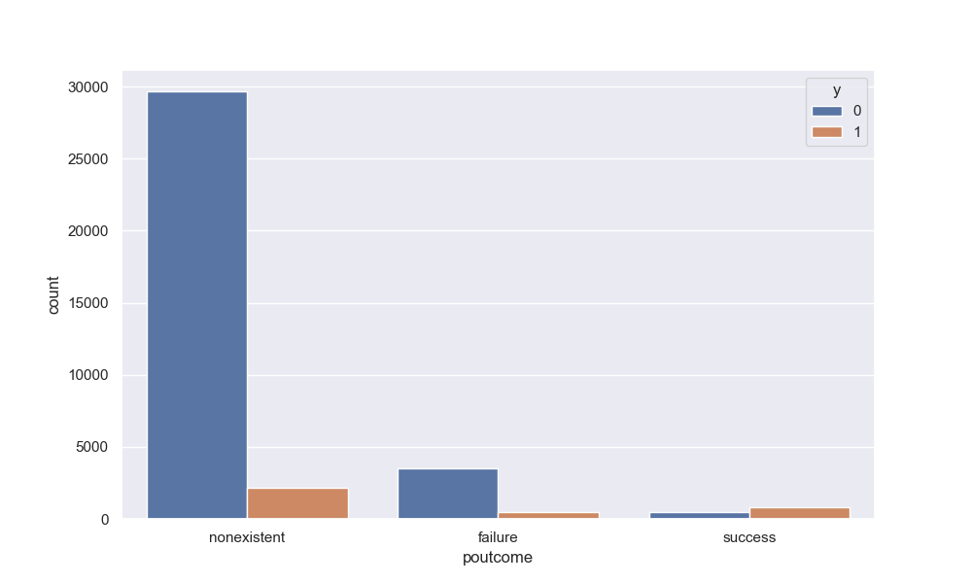
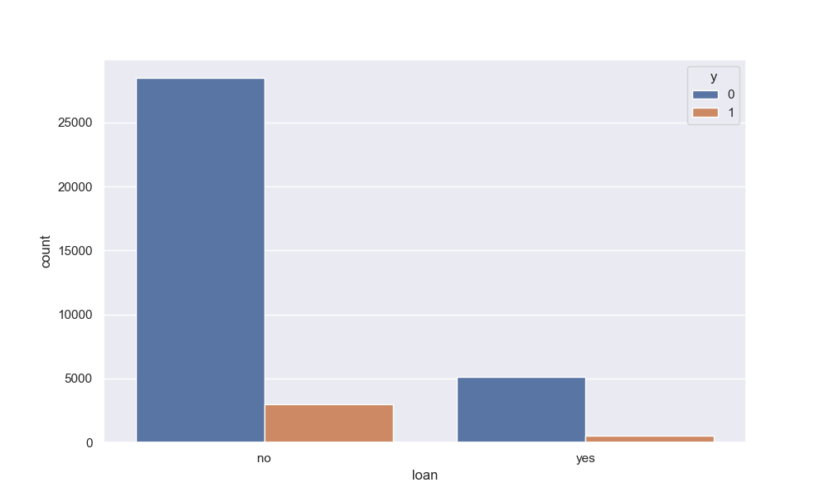
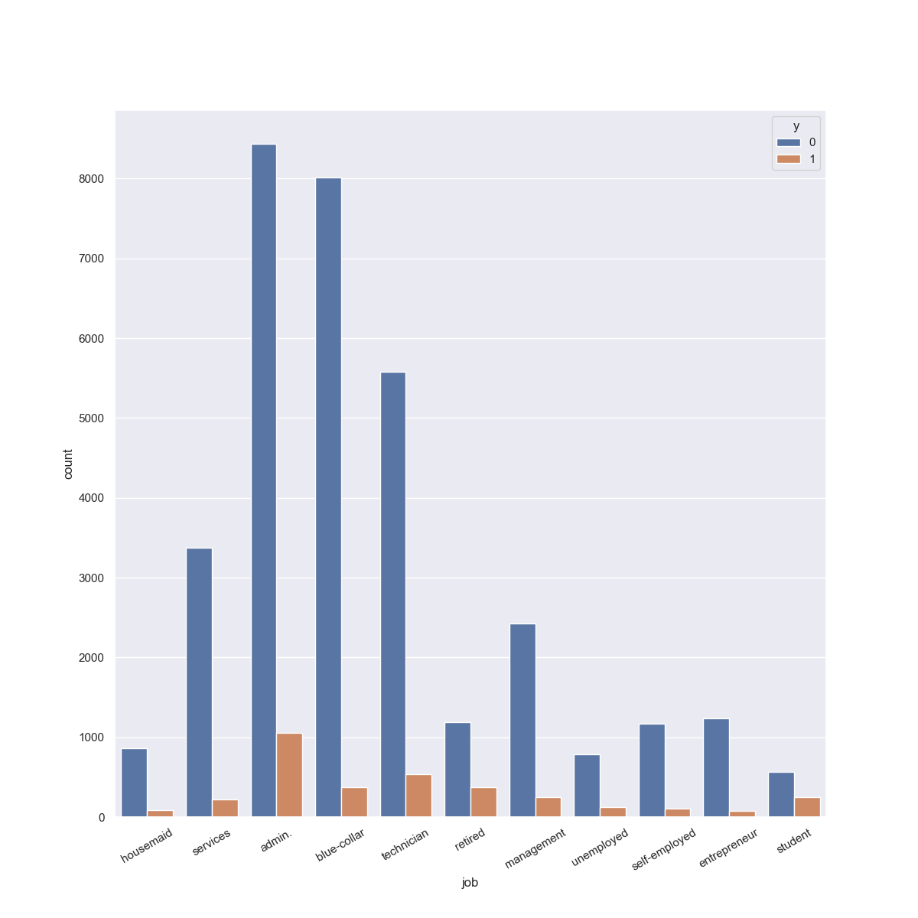
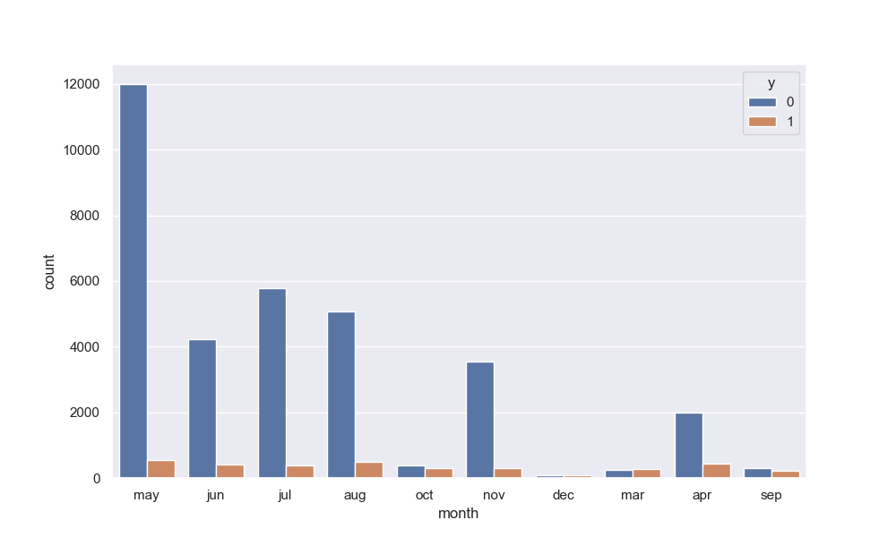
EDA Results: Distribution of Categorical features

Slide 12
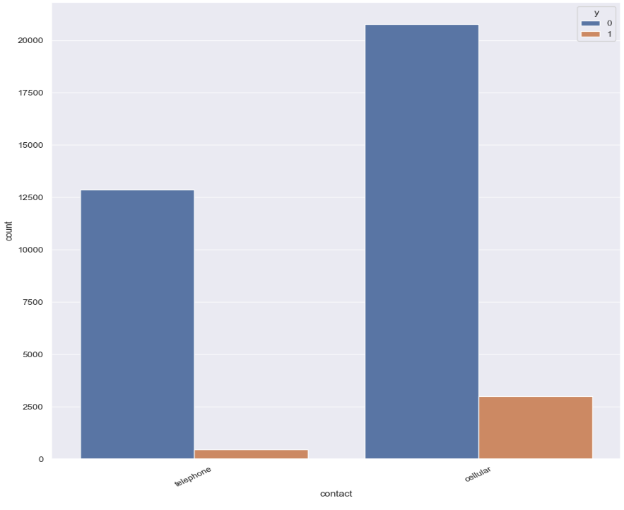
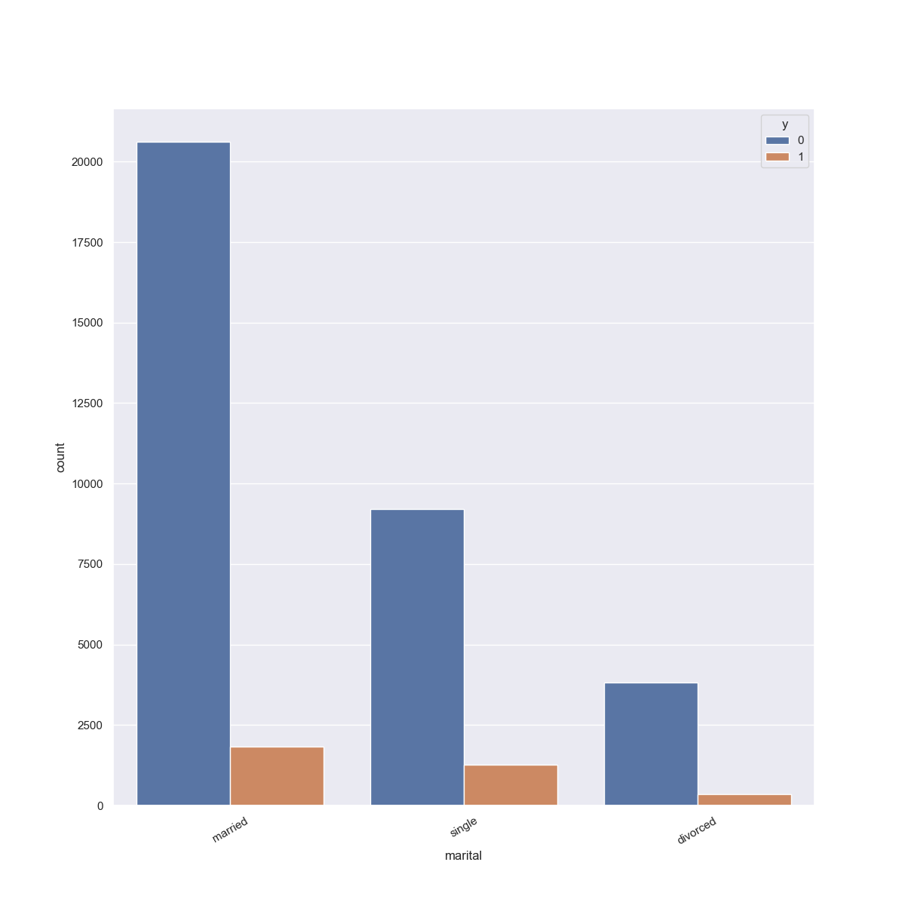
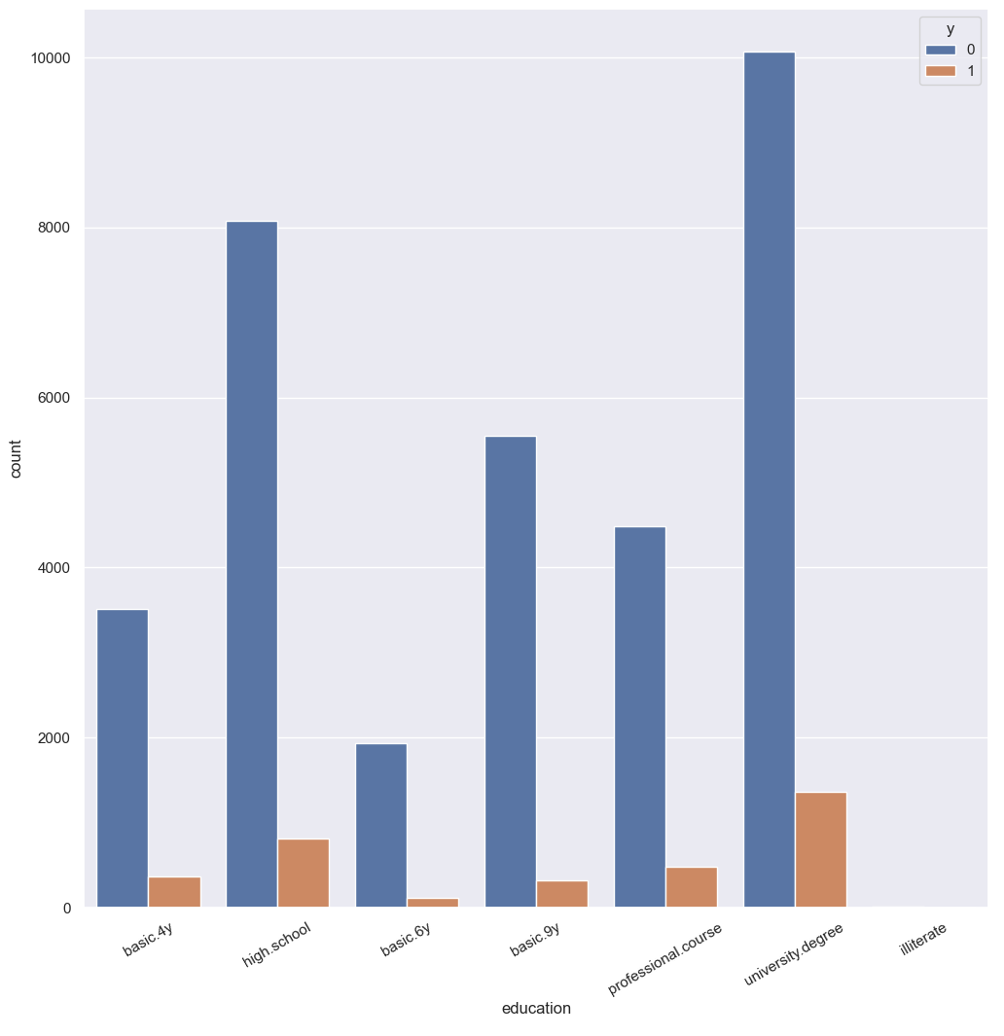
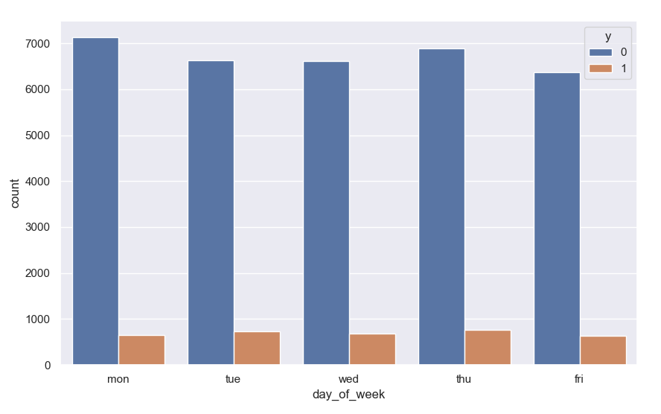
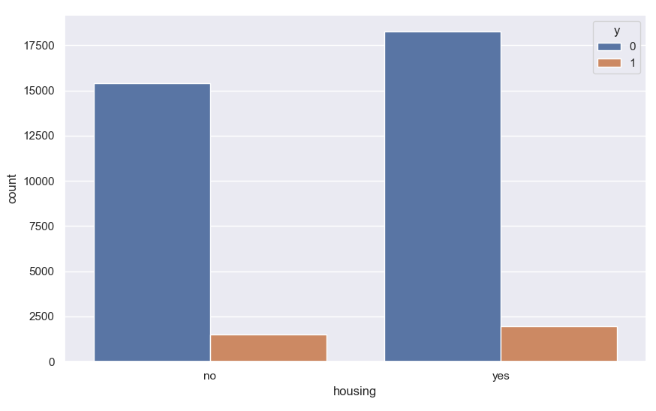
EDA Results: Distribution of Categorical features

Slide 13
EDA Results: % of subscriptions for each category
Feature name | % of subscriptions for each category
job | housemaid: 9.062 % ; services: 6.102 % ; admin.: 11.116 % ; blue-collar: 4.458 % ; technician: 8.806 % ; retired: 24.092 % ; management: 9.220 % ; unemployed: 13.377 % ; self-employed: 8.091 % ; entrepreneur: 5.998 % ; student: 30.494 %
marital | married: 8.128 % ; single: 12.133 % ; divorced: 8.467 %
education | basic.4y: 9.375 % ; high.school: 9.139 % ; basic.6y: 5.439 % ; basic.9y: 5.416 % ; professional.course: 9.582 % ; university.degree: 11.937 % ; illiterate: 18.750 %
housing | no: 8.784 % ; yes: 9.724 %
loan | no: 9.387 % ; yes: 8.791 %
contact | telephone: 3.334 % ; cellular: 12.637 %
month | may: 4.361 % ; jun: 9.052 % ; jul: 6.159 % ; aug: 8.734 % ; oct: 43.175 % ; nov: 8.115 % ; dec: 48.193 % ; mar: 50.289 % ; apr: 18.100 % ; sep: 43.536 %
day_of_week | mon: 8.294 % ; tue: 9.874 % ; wed: 9.339 % ; thu: 10.034 % ; fri: 8.953 %
poutcome | nonexistent: 6.701 % ; failure: 12.325 % ; success: 64.397 %

Slide 14
EDA Results: Observations for Categorical features
Observations:
job: 'admin','blue-collar' and 'technician' jobs were contacted most. 'Retired' and 'Student' categories gave the highest percentage of subscriptions
marital: most of the people contacted were married. The percentage of subscriptions didn't seem to change much with marital status
education: most of the people contacted had either 'university.degree' or 'high.school' as their highest level of education. Though, 'illiterate' customers gave the highest percentage of subscriptions
housing: There is no imbalance observed with respect to housing. The percentage of subscription also seems to be constant.
loan: Most of the people contacted didn't have a personal loan. People without personal loan did seem to be more likely to subscribe but the difference between the two categories is small.
contact: most of the people were contacted through a cellphone. This did result in a significantly higher percentage of subscriptions.
month: During the months of January and February, there were no significant calls reported. However, the highest number of calls were recorded in May, which is likely attributed to the beginning of a new financial year and the customary annual increments for employees. Most of the contacts were made in the second quarter. Some months gave a significantly higher percentage of subscriptions than other months, but the trend is not very clear and there may be other factors at play here.
day_of_week: Number of contacts and percentage of subscriptions doesn't seem to change much with day of the week.
poutcome: The outcome of previous campaigns was "nonexistent" for most of the contacts. Although, the success of previous campaigns did seem to positively impact the subscriptions of current campaign.

Slide 15
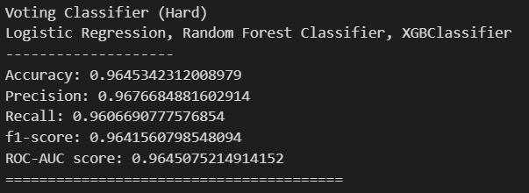
ML Model Training: Yash Doshi’s Summary
Preprocessing steps: One-hot encoding and ADASYN Over-sampling
Validation Statistics
Model | Accuracy | Precision | Recall | F1-Score | ROC-AUC Score | Time taken (seconds)
Logistic Regression | 0.8748246 | 0.8559474 | 0.899215 | 0.8770479 | 0.874994532 | 9.955815315
Decision Tree Classifier | 0.9474669 | 0.9425109 | 0.952276 | 0.9473684 | 0.947500377 | 6.898710489
Random Forest Classifier | 0.9657054 | 0.9740966 | 0.956358 | 0.9651458 | 0.965640264 | 224.9213924
KNN Classifier | 0.9186282 | 0.8601569 | 0.99843 | 0.92415 | 0.919184111 | 18.17452931
XGBoost Classifier | 0.9653936 | 0.9731715 | 0.956672 | 0.9648512 | 0.965332854 | 56.66882825
Gradient Boosting Classifier | 0.9614965 | 0.9696292 | 0.952276 | 0.9608744 | 0.961432265 | 496.8134048
Voting Classifier (Soft) | 0.9625877 | 0.9529376 | 0.972684 | 0.9627098 | 0.962658019 | 60.23903847
Voting Classifier (Hard) | 0.9630553 | 0.9626491 | 0.962951 | 0.9628002 | 0.963054615 | 61.30061078
Testing Statistics for the best model

Slide 16
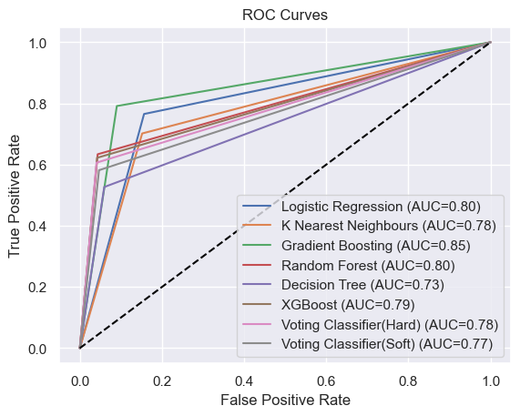
ML Model Training: Yash Jadwani’s Summary
Preprocessing steps: Label encoding and SMOTE Over-sampling
Model | Training Accuracy | Test Statics
Model | Training Accuracy | Accuracy | Precision | Recall | F1-Score | ROC-AUC Score | Correct label predicted (7418)
Logistic Regression | 0.8698 | 0.84 | 0.33 | 0.77 | 0.47 | 0.8 | 6204
Random Forest Classifier | 0.9517 | 0.93 | 0.60 | 0.63 | 0.62 | 0.80 | 6873
Decision Tree | 0.9352 | 0.90 | 0.48 | 0.53 | 0.50 | 0.73 | 6691
Xg Boost | 0.9411 | 0.93 | 0.60 | 0.62 | 0.61 | 0.79 | 6874
K Nearest Neighbors | 0.9163 | 0.83 | 0.32 | 0.70 | 0.44 | 0.78 | 6191
Gradient Boosting | 0.9281 | 0.90 | 0.47 | 0.79 | 0.59 | 0.85 | 6668
Voting Classifier(Hard) | 0.9480 | 0.93 | 0.60 | 0.61 | 0.61 | 0.78 | 6872
Voting Classifier(Soft) | 0.9449 | 0.92 | 0.56 | 0.58 | 0.57 | 0.77 | 6815

Slide 17
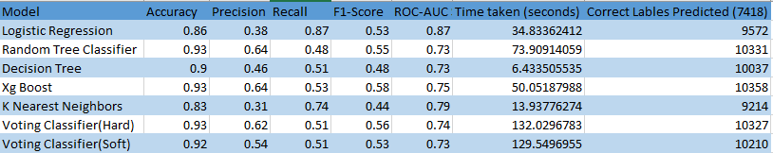
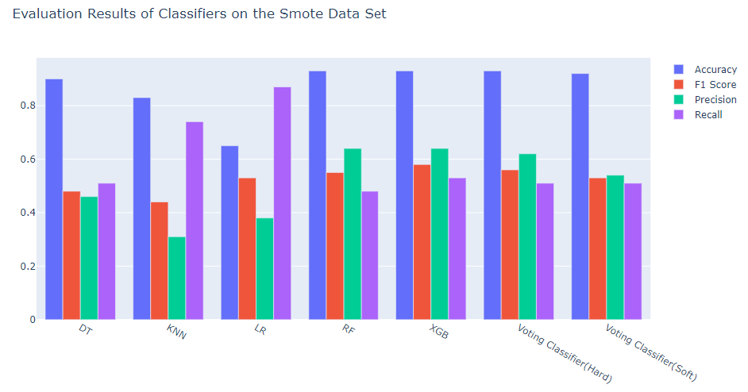
ML Model Training: Harold Wilson’s Summary
Preprocessing steps: One-hot encoding and SMOTE Over-sampling
The XGB Classifier produce quite a good and stable performance in terms of the evaluation metrics, with the highest recall score which was able to correctly predict many of the customers more likely to buy a bank product in less than a minute of operation time. The insights gained from the ML model, will allow ABC Bank to optimize their marketing campaigns, and tailor their marketing messages to specific customers, thereby improving their overall customer acquisition strategy.

Slide 18
ML Model Training: Anuj Singh’s Summary
Preprocessing steps: Label encoding and ADASYN Over-sampling
Model | Accuracy | Precision | Recall | F1-Score | ROC-AUC Score | Time taken (seconds)
Logistic Regression | 0.915754 | 0.6148649 | 0.320423 | 0.4212963 | 0.649590809 | 2.526189089
Decision Tree Classifier | 0.9165965 | 0.6076696 | 0.362676 | 0.4542448 | 0.668947493 | 1.316695213
Random Forest Classifier | 0.9262005 | 0.6747312 | 0.441901 | 0.5340426 | 0.709678112 | 62.54643035
KNN Classifier | 0.9063185 | 0.524 | 0.230634 | 0.3202934 | 0.604230633 | 7.780421972
XGBoost Classifier | 0.9278854 | 0.6598174 | 0.508803 | 0.5745527 | 0.740520283 | 41.20754647
Gradient Boosting Classifier | 0.9275484 | 0.6627358 | 0.494718 | 0.5665323 | 0.734037001 | 93.62231922
Voting Classifier (Soft) | 0.9262005 | 0.6719577 | 0.447183 | 0.5369979 | 0.712039472 | 28.39676476
Voting Classifier (Hard) | 0.9258635 | 0.6748634 | 0.434859 | 0.5289079 | 0.70634331 | 29.57933927

Slide 19
Final Recommendations
Statistics of the best model found by each team member:
Team Member | Encoding Method | Over-Sampling Method | Best model name | Accuracy | Precision | Recall | f1-score | ROC-AUC Score | Training time (seconds)
Yash Doshi | One-Hot | ADASYN | Voting Classifier (Hard): Logisitic Regression, Random Forest Classifier, XGBClassifier | 0.9645 | 0.9677 | 0.961 | 0.9641 | 0.9645 | 61.3
Yash Jadwani | Label | SMOTE | Random Forest Classifier | 0.93 | 0.6 | 0.63 | 0.62 | 0.8 | 47.54
Harold Wilson | One-Hot | SMOTE | XGBoost Classifier | 0.93 | 0.64 | 0.53 | 0.58 | 0.75 | 50.05
Anuj Singh | Label | ADASYN | XGBoost Classifier | 0.928 | 0.6599 | 0.509 | 0.5745 | 0.7405 | 41.21
Choosing Voting Classifier (Hard) as the best model since it provided the best testing statistics

Slide 20
Thank You

